Slide 1
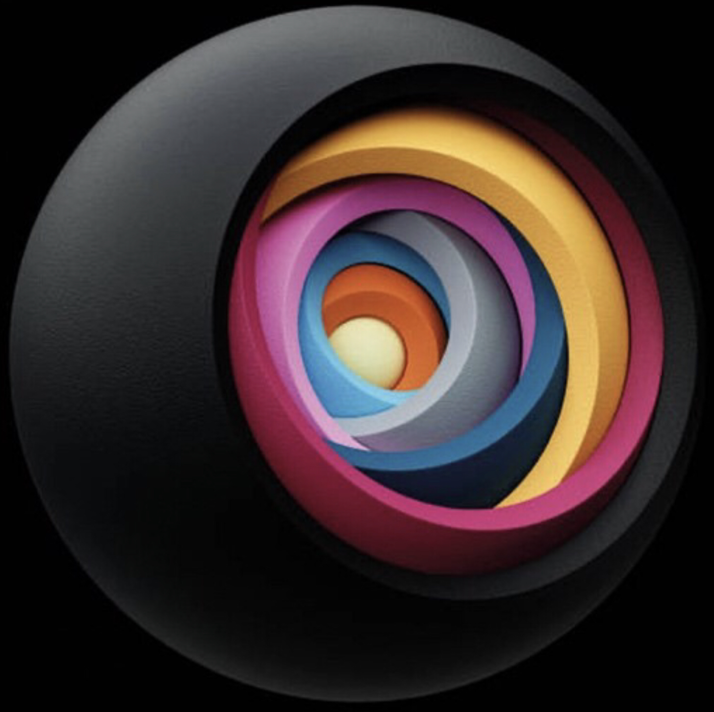
Artificial Intelligence
Neil D. Lawrence

Slide 2
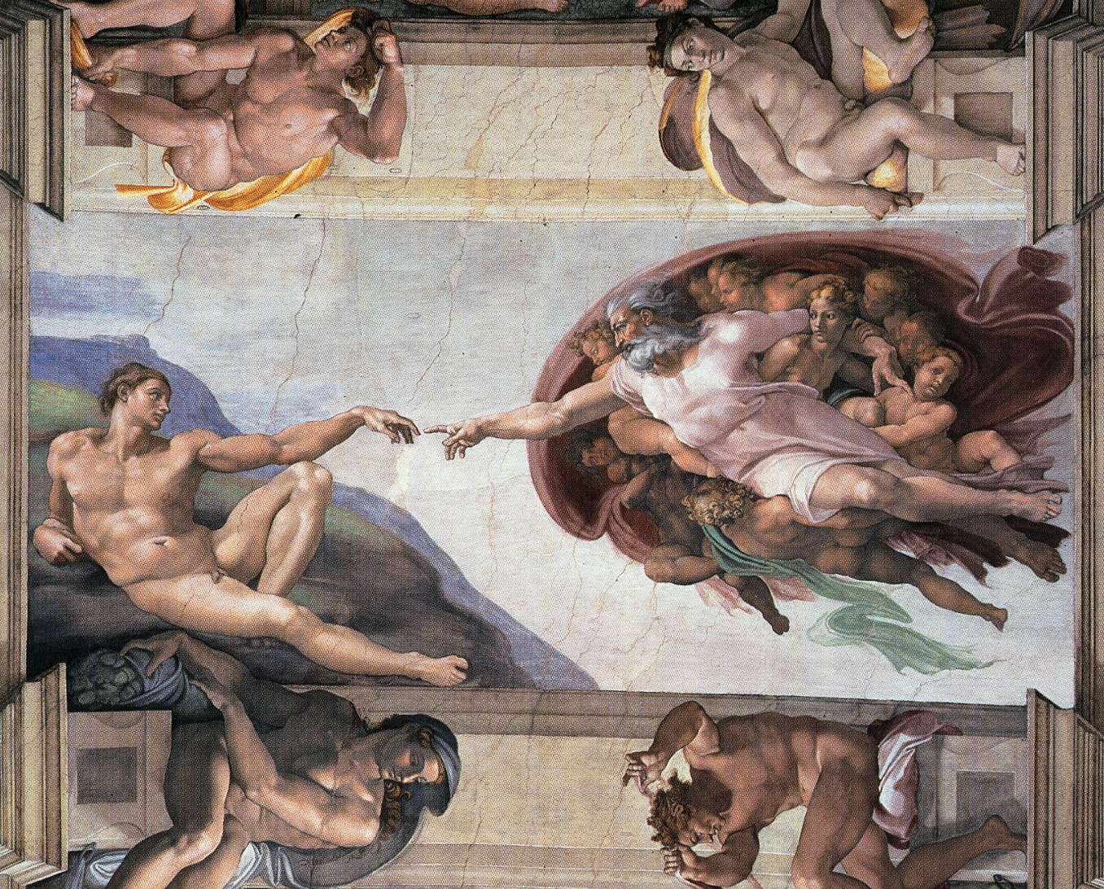

Slide 3
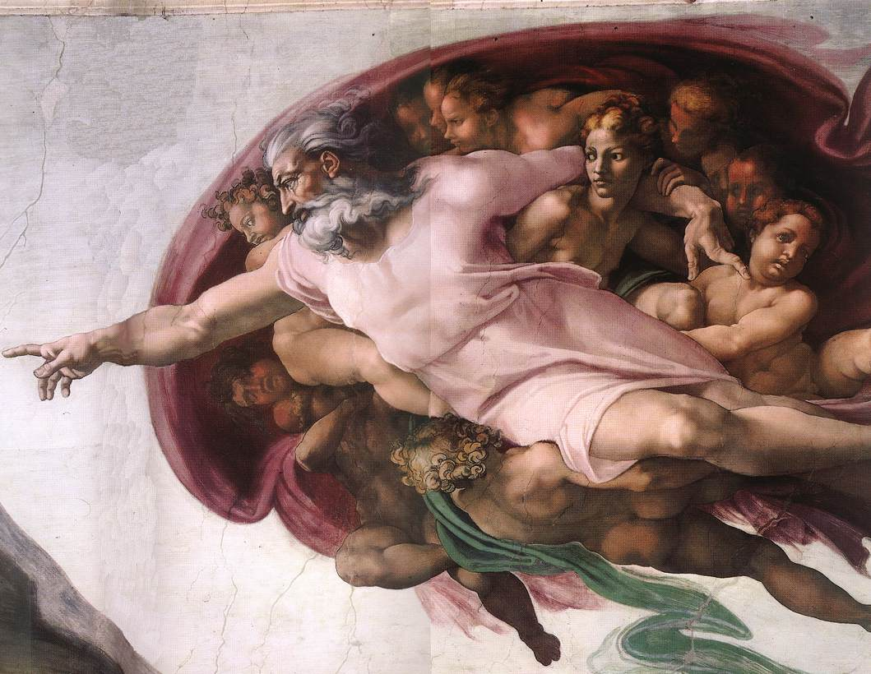

Slide 4
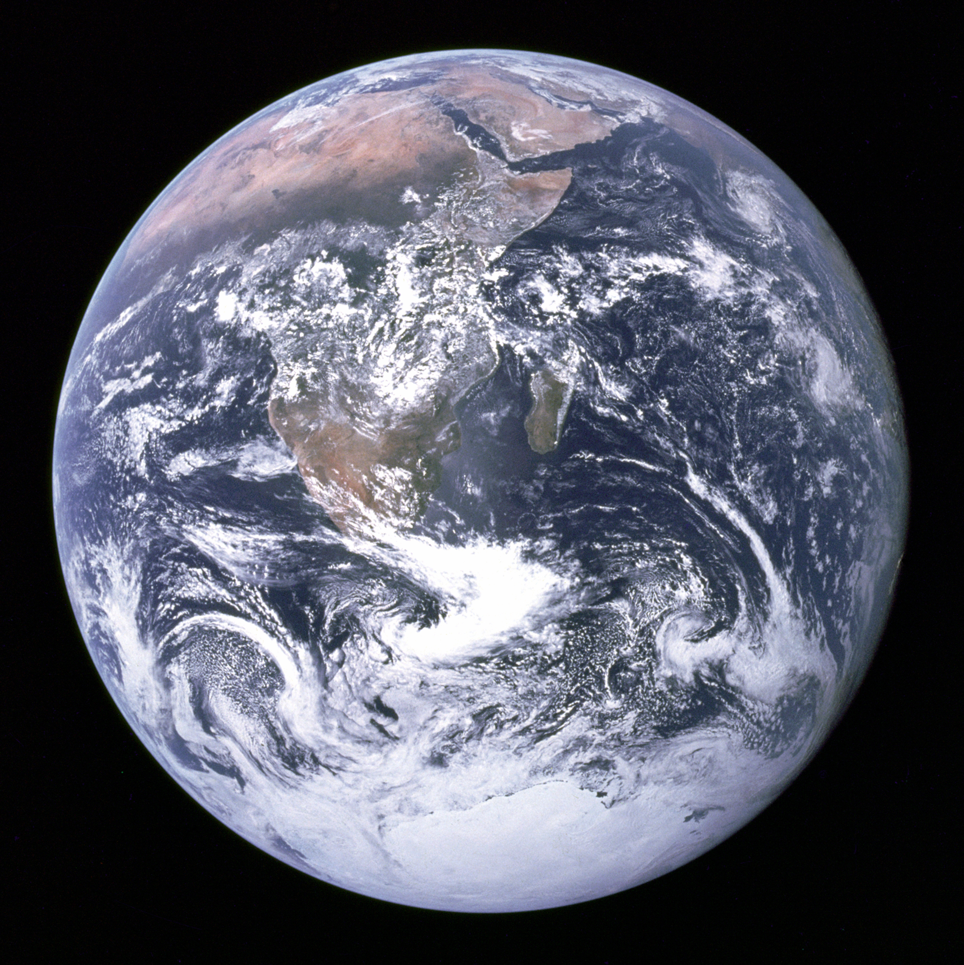
Notes:
The ”Blue Marble” photographed by Apollo 17.

Slide 6
?
!#@%&?
#
!
&
!
£*?$&!
&
?
#

Slide 7
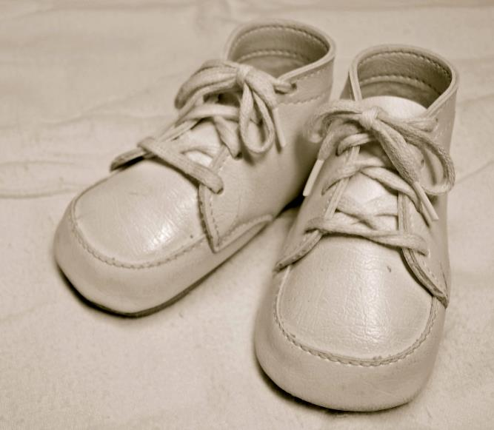
For Sale, Baby Shoes, Never Worn

Slide 8
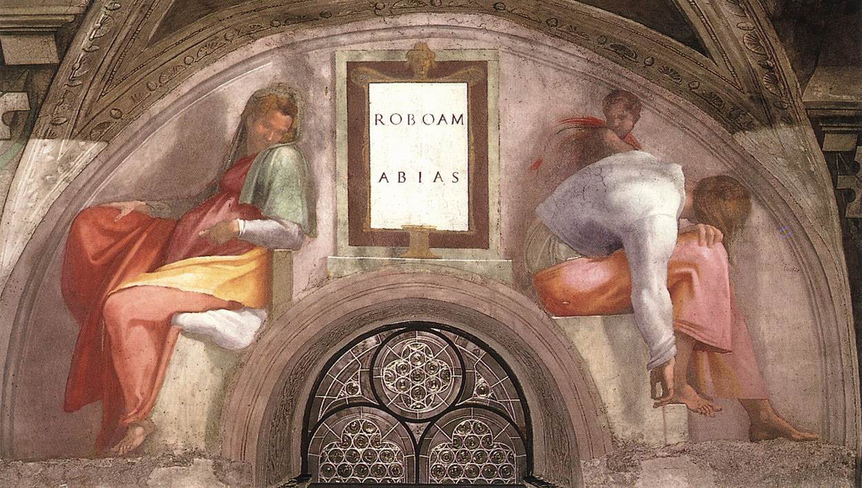

Slide 9
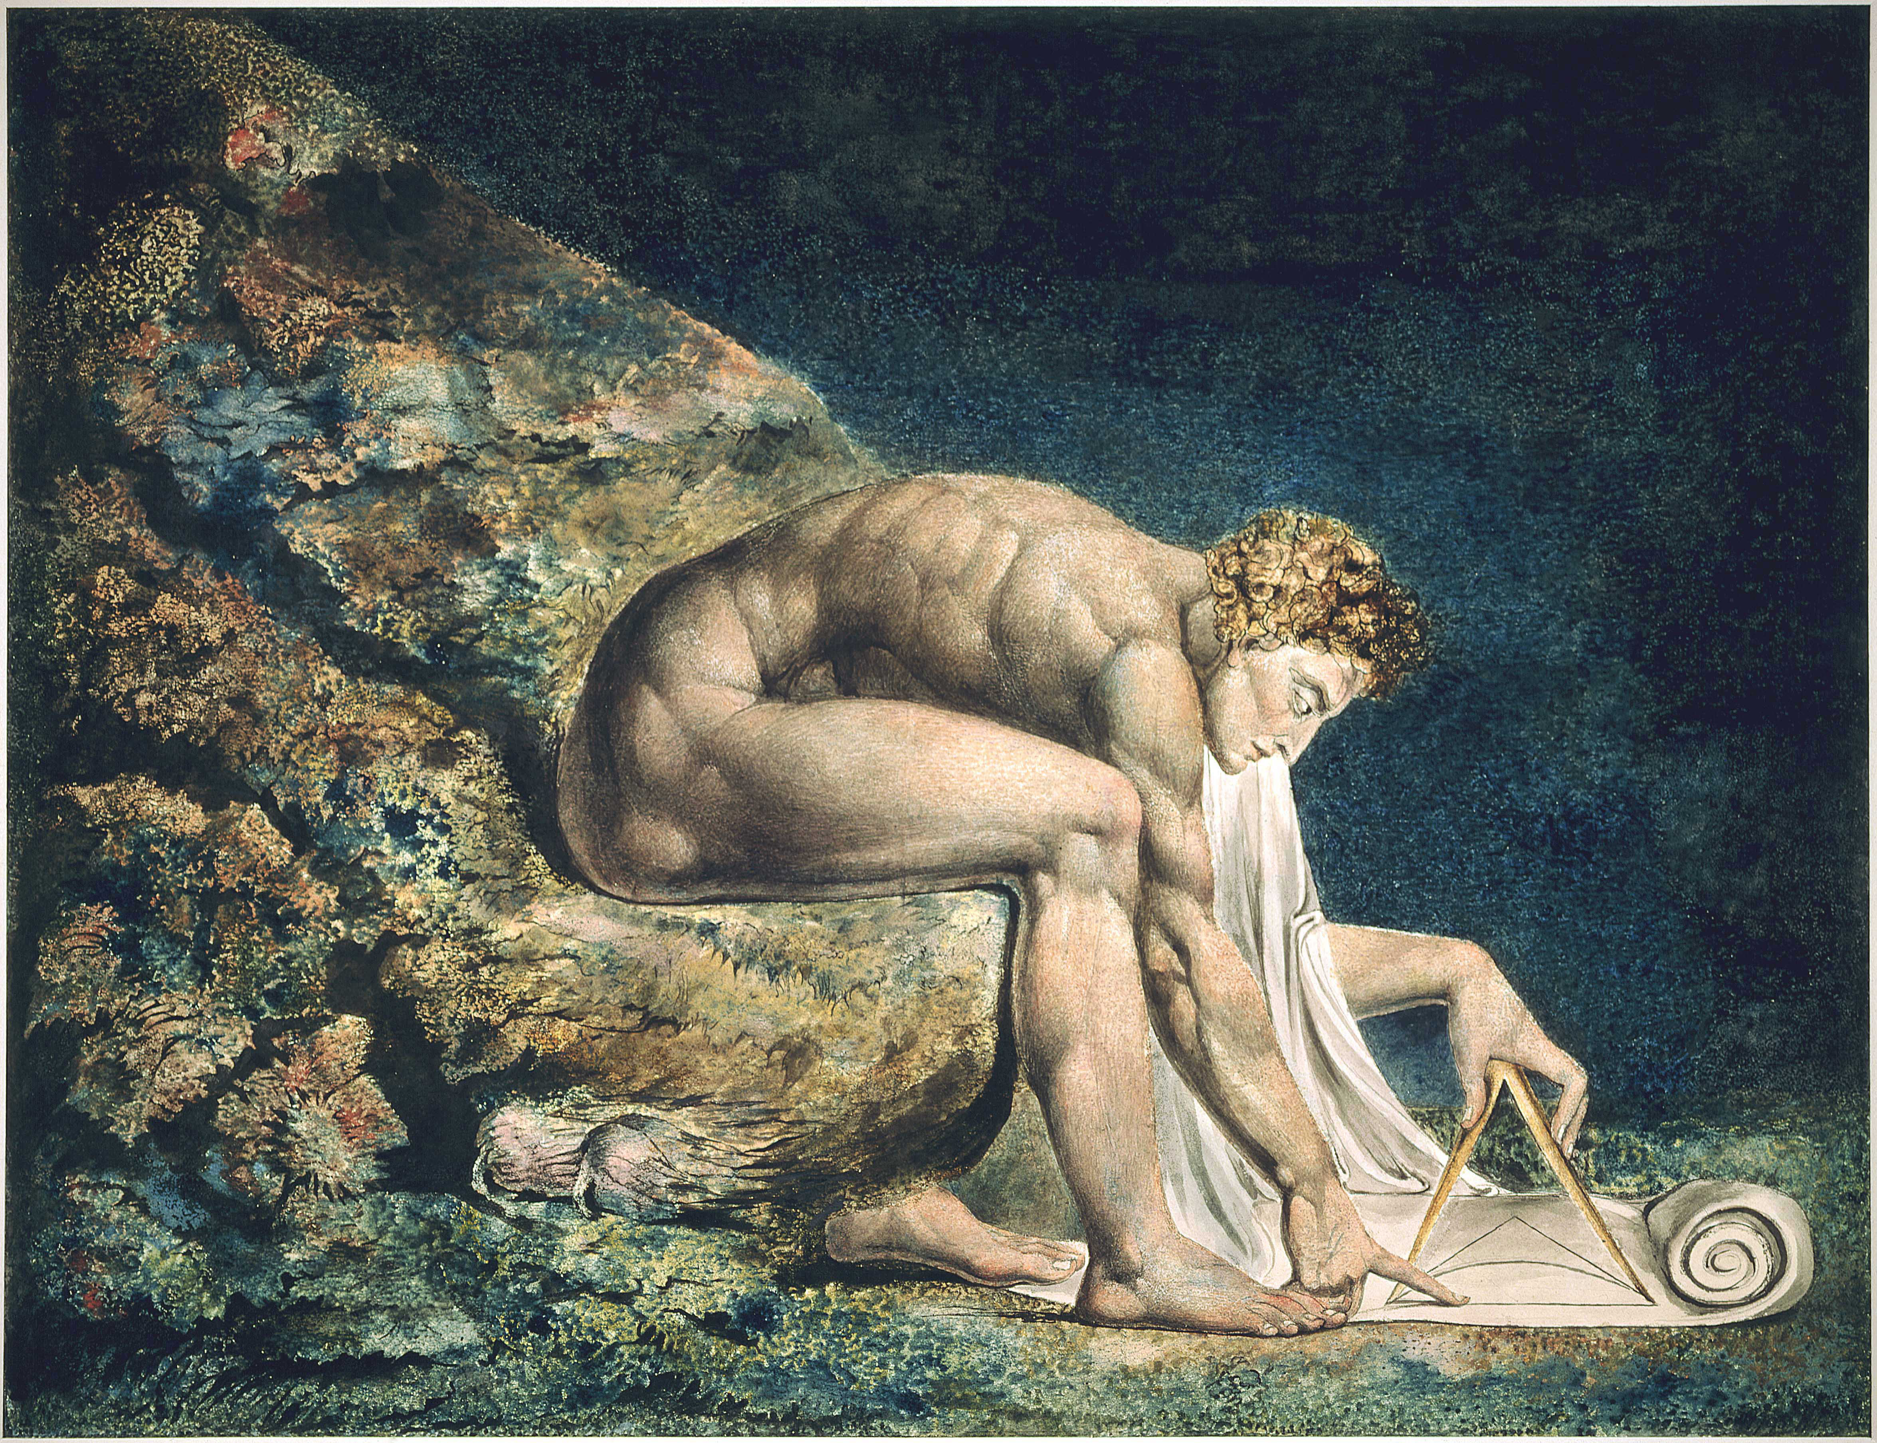

Slide 10
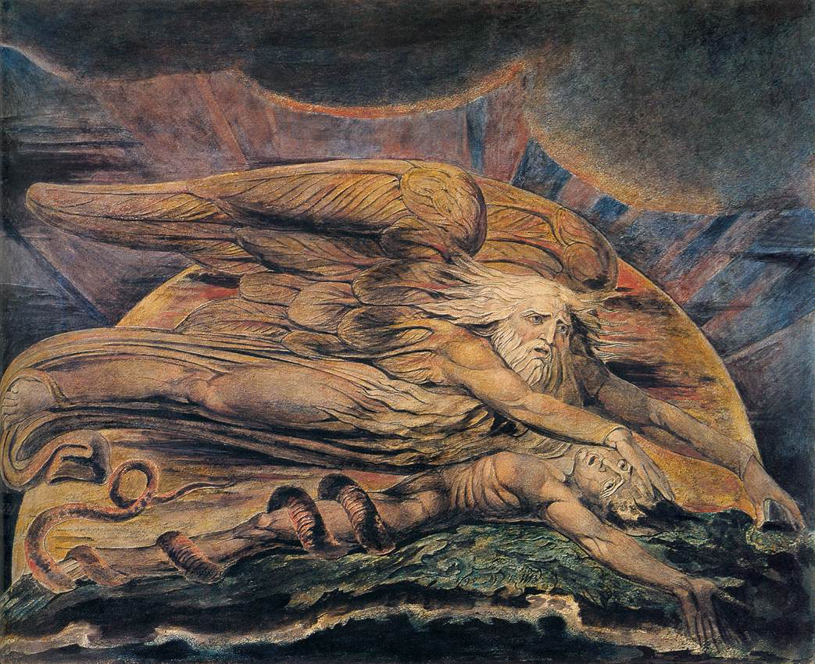

Slide 11
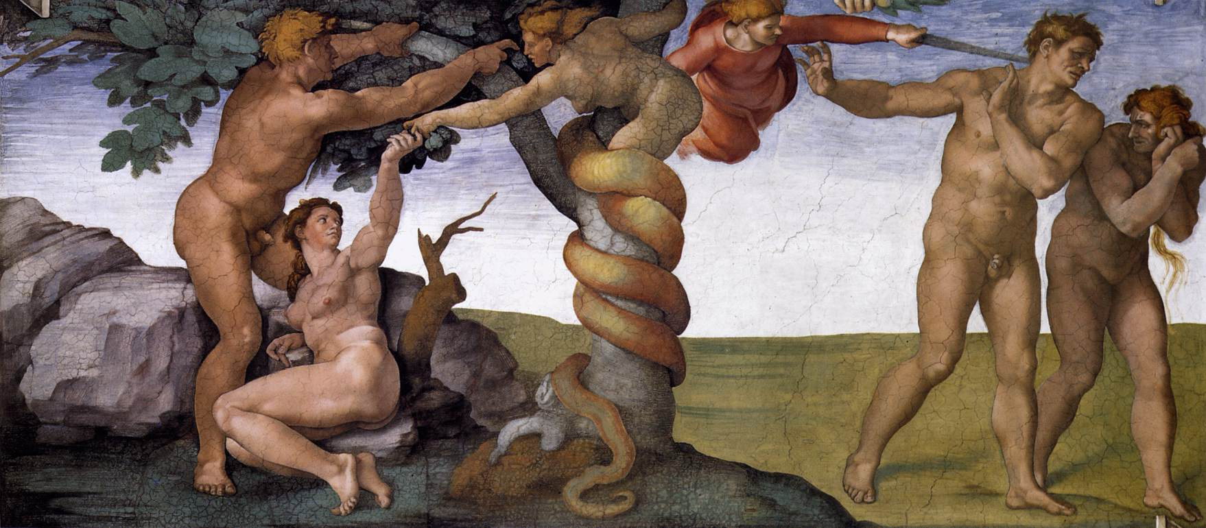

Slide 12


Slide 13
complexity
bandwidth

